Slide 1
SECURE DATA HIDING IN IMAGES USING STEGANOGRAPHY
CAPSTONE PROJECT
Presented By: Rohit Raj Kashyap
College Name & Department : Sagar Institute of Research & Technology
Computer Science & Engineering

Slide 2
OUTLINE
Problem Statement
Technology used
Wow factor
End users
Result
Conclusion
Git-hub Link
Future scope

Slide 3
Problem Statement
With increasing cyber threats, secure communication is crucial. Steganography enables hidden data transmission within images, ensuring confidentiality without attracting attention.

Slide 4
Technology used
- Python
- Libraries: OpenCV, PIL, NumPy, Stegano
- Techniques: LSB, DCT, DWT
- Framework: Flask/Django

Slide 5
Wow factors
- Invisible Data Hiding
- High Security (Encryption & Steganography)
- Supports LSB, DCT, DWT
- Robust Extraction Post Compression
- User-friendly GUI

Slide 6
End users
- Government & Intelligence Agencies
- Cybersecurity Experts
- Journalists & Activists
- Corporate Sector

Slide 7
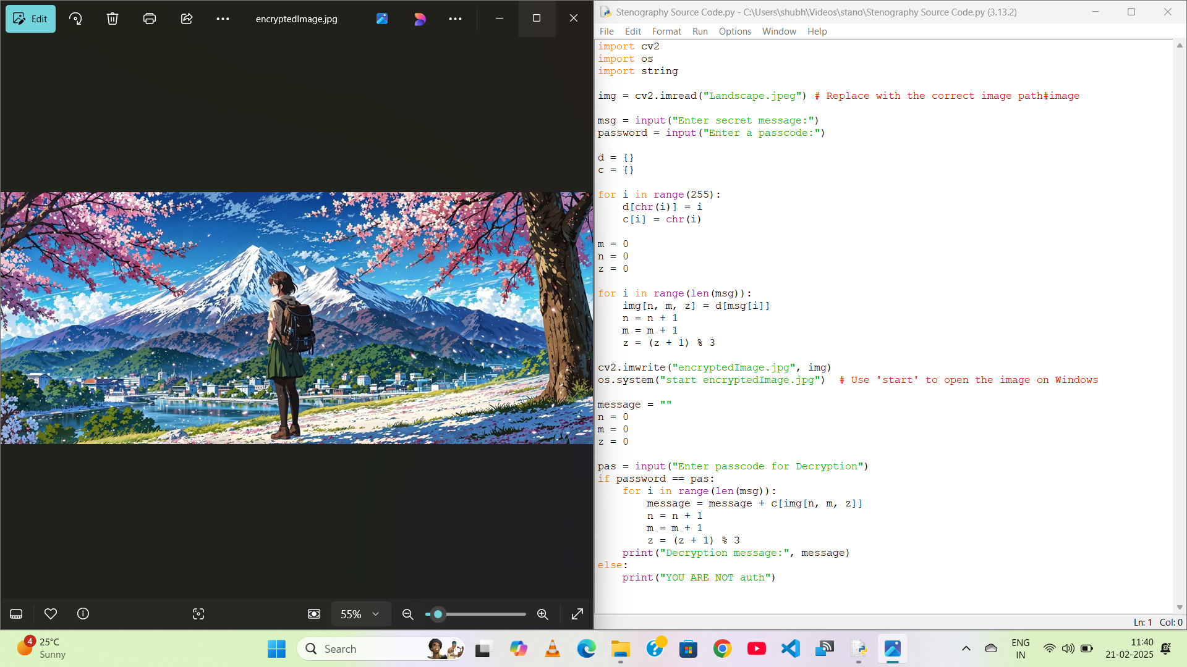
Results

Slide 8
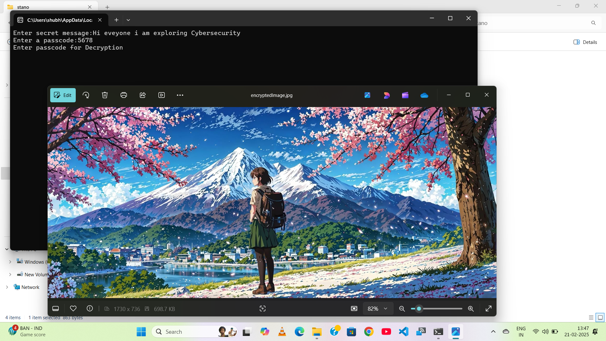


Slide 9
Conclusion
Steganography enables secure communication by hiding data in images. The project ensures confidentiality, integrity, and undetectability of hidden messages.

Slide 10
GitHub Link
README.md
https://github.com/Rohit-kyp/Data-hiding-using-Stenography.git

Slide 11
Future scope(optional)
- AI-based Steganalysis Detection
- Video & Audio Steganography
- Blockchain Integration for Security
- Real-time Steganography in Messaging

Slide 12
THANK YOU

